Slide 1

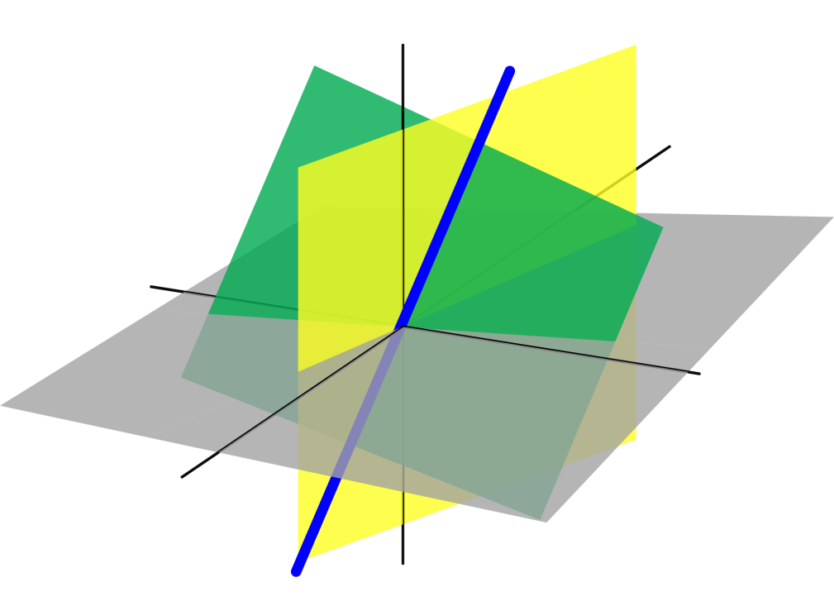
Azərbaycan Dövlət Neft və Sənaye Universiteti
Analytic Geometry

Slide 2
Space Coordinates
and
Vectors in Space

Slide 3
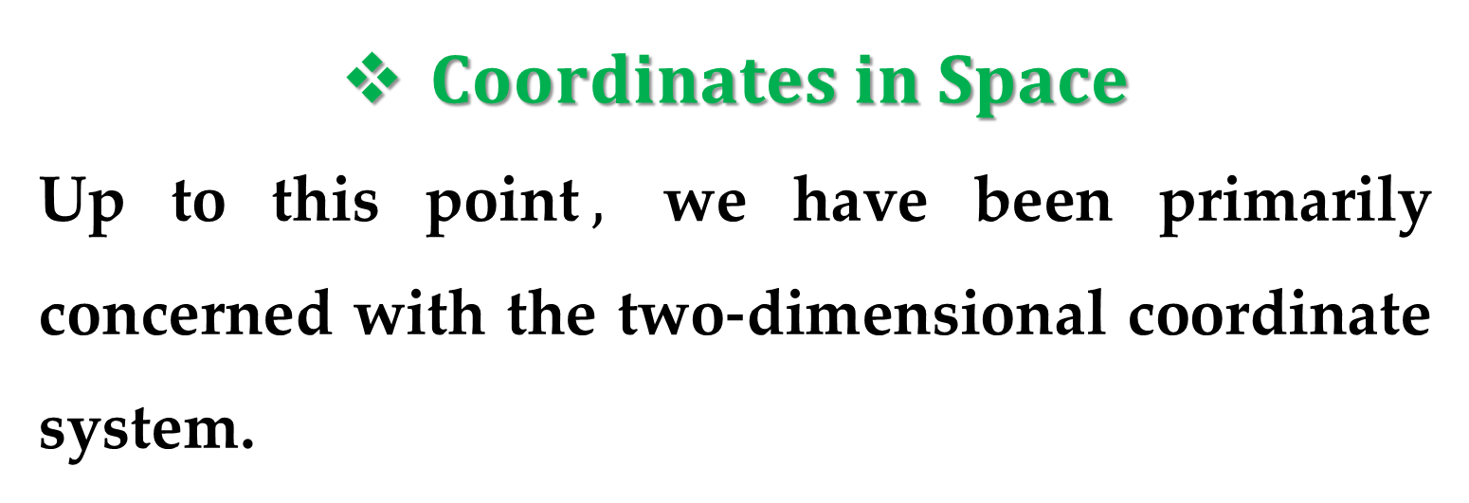
$Coordinates in Space$
Up to this point$,$ we have been primarily concerned with the two-dimensional coordinate system.
Much of the practical and most important problems encountered in analytic geometry and calculus involve the three-dimensional coordinate system.

Slide 4
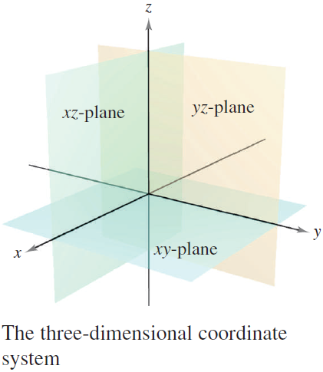
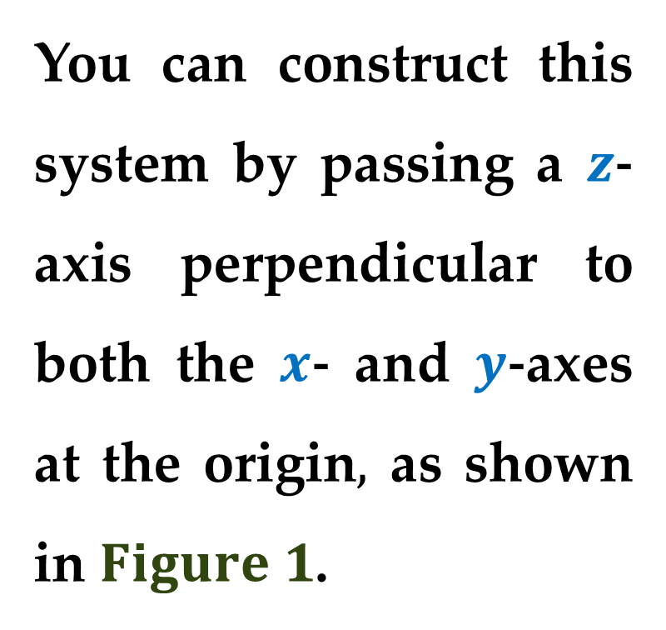
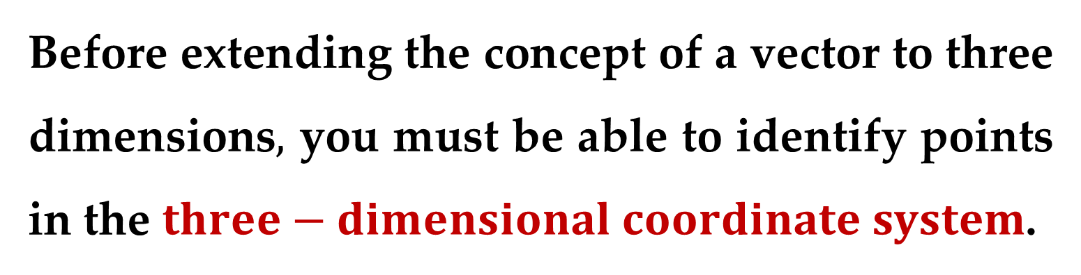
Before extending the concept of a vector to three dimensions$,$ you must be able to identify points in the $three−dimensional coordinate system$.
You can construct this system by passing a $z$-axis perpendicular to both the $x$- and $y$-axes at the origin$,$ as shown in $Figure 1$.

Slide 5
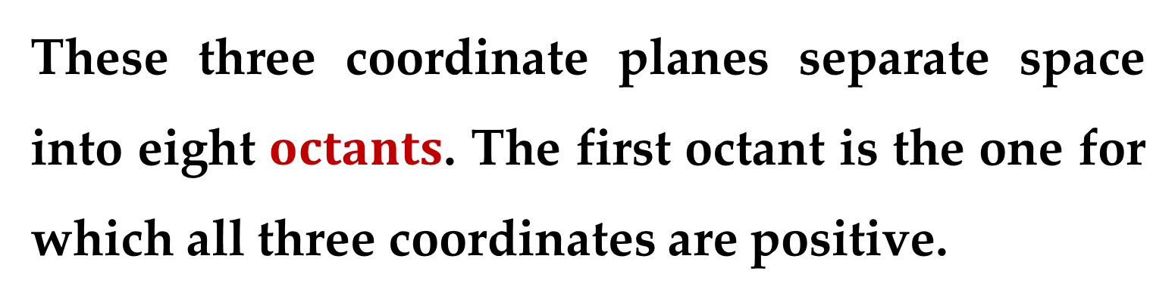

Taken as pairs, the axes
determine three
$coordinate planes$:
the $xy−$plane$;$
the $xz−$plane$;$
the $yz−$plane$.$
These three coordinate planes separate space into eight $octants$. The first octant is the one for which all three coordinates are positive.

Slide 6
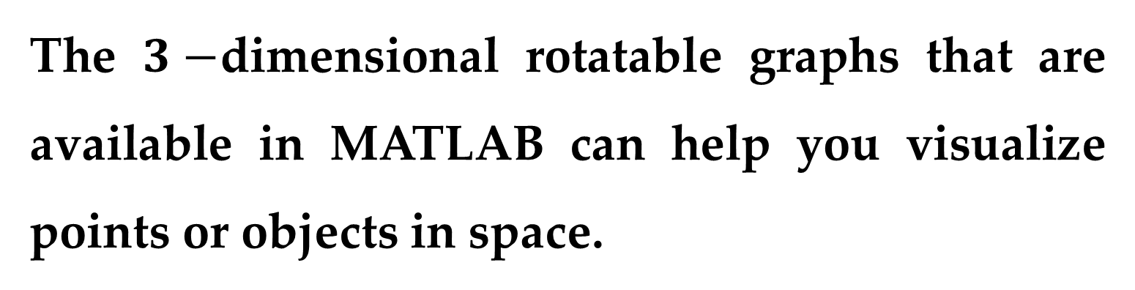
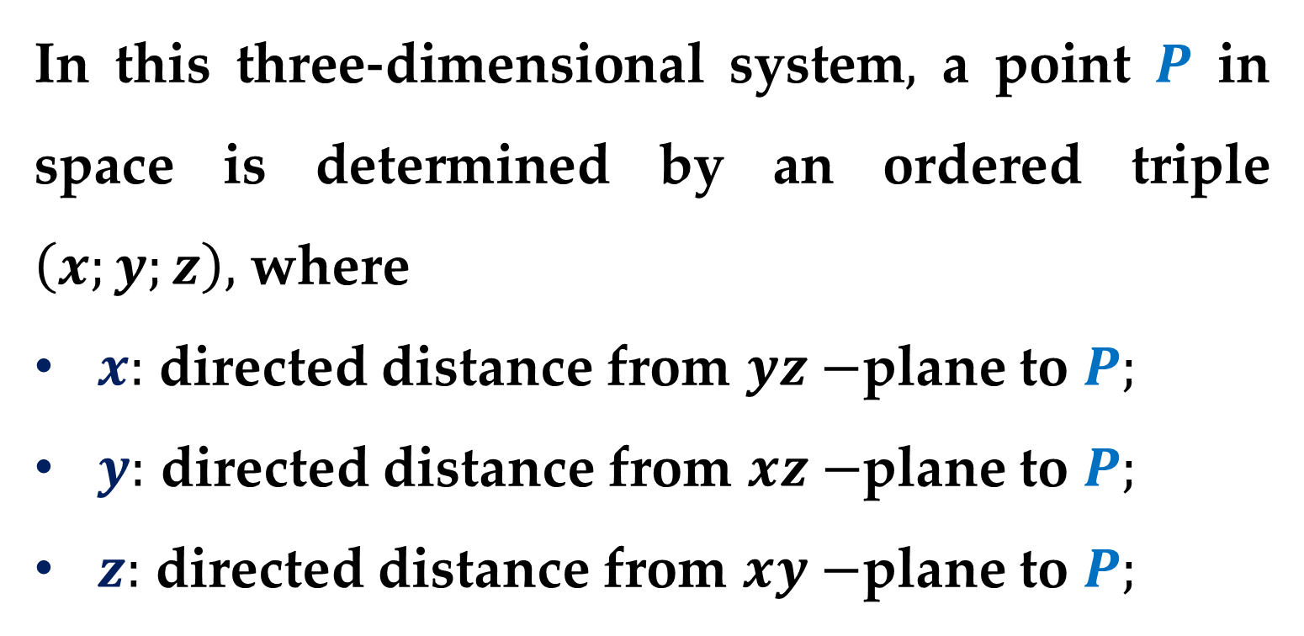
In this three-dimensional system$,$ a point $P$ in space is determined by an ordered triple $\left(x;y;z\right),$ where
$x:$ directed distance from $yz−$plane to $P;$
$y:$ directed distance from $xz−$plane to $P;$
$z:$ directed distance from $xy−$plane to $P;$
The $3−$dimensional rotatable graphs that are available in MATLAB can help you visualize points or objects in space.

Slide 7
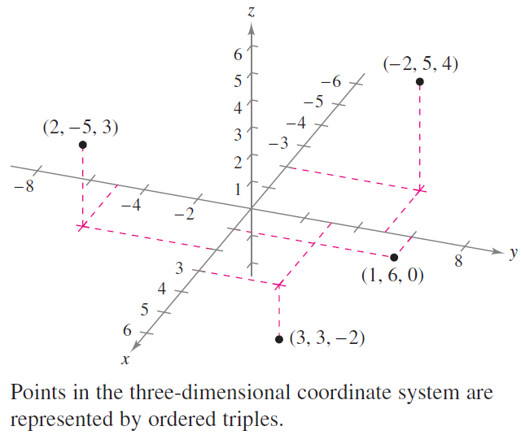
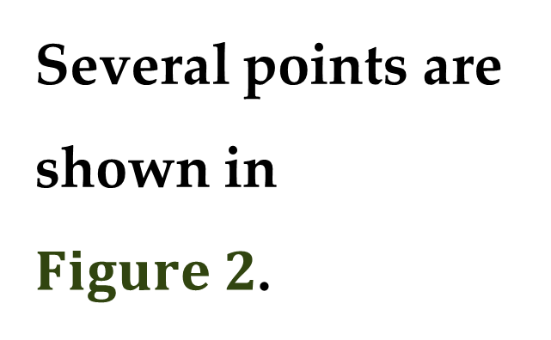
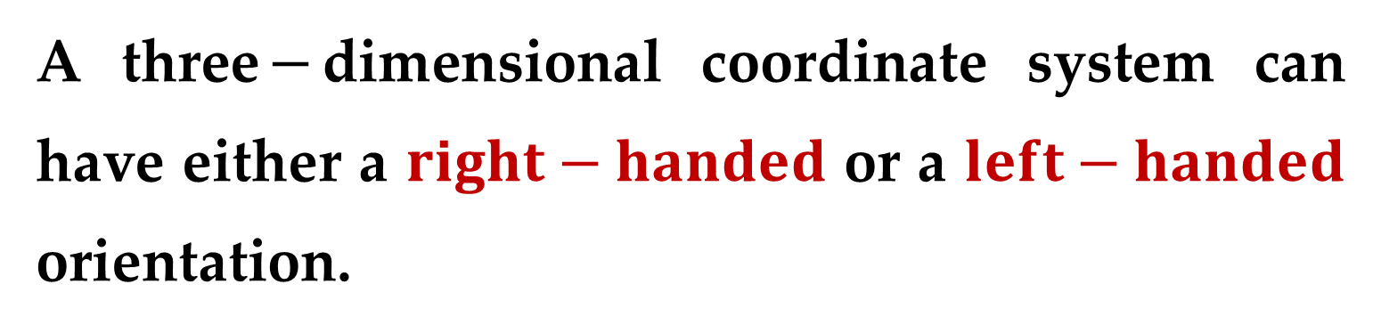
Several points are shown in $Figure 2$.
A three$−$dimensional coordinate system can have either a $right−handed$ or a $left−handed$ orientation.

Slide 8
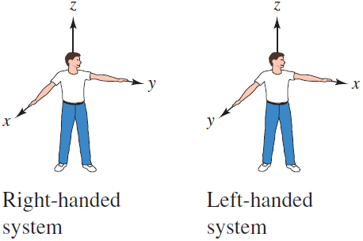
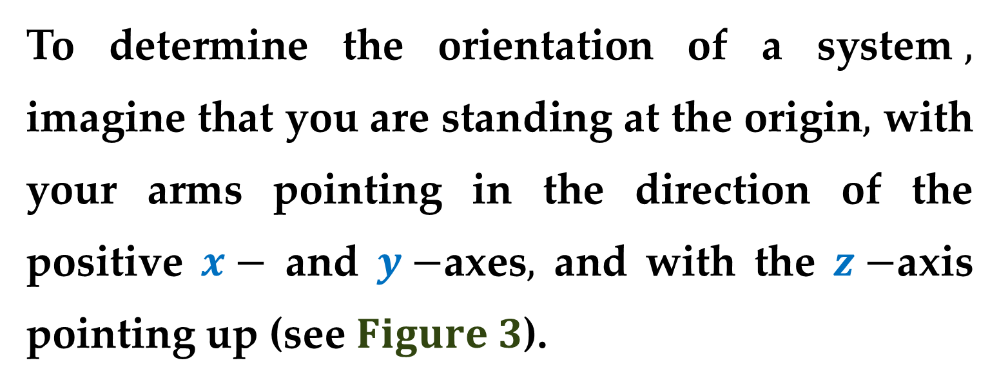
To determine the orientation of a system$,$ imagine that you are standing at the origin$,$ with your arms pointing in the direction of the positive $x−$ and $y−$axes$,$ and with the $z−$axis pointing up (see $Figure 3$).

Slide 9
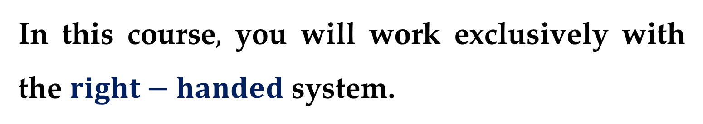
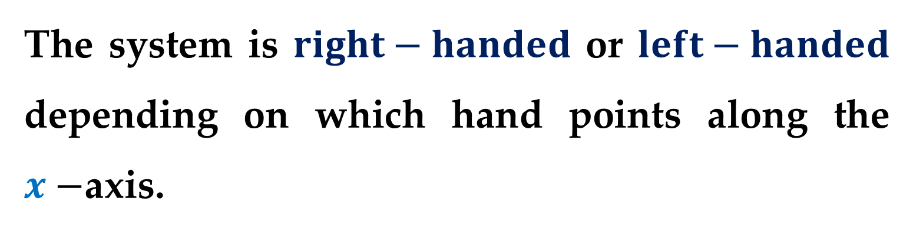
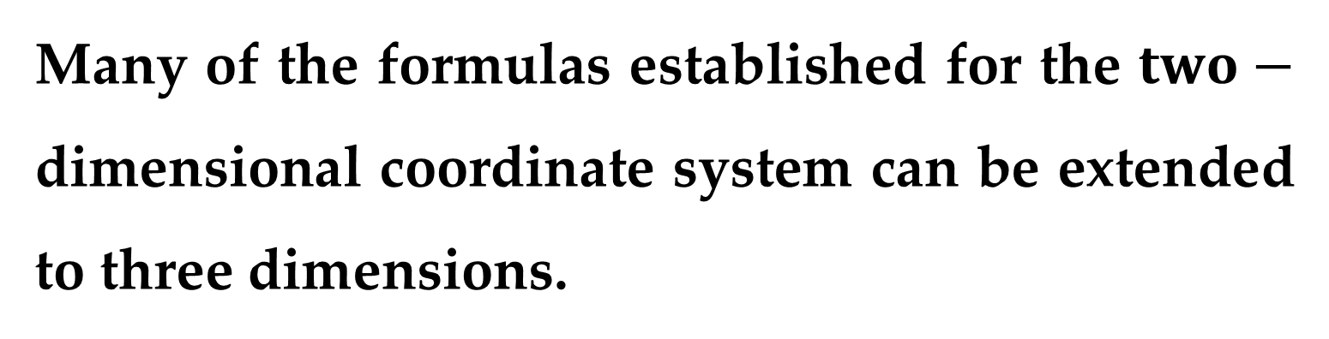
The system is $right−handed$ or $left−handed$ depending on which hand points along the $x−$axis.
In this course$,$ you will work exclusively with the $right−handed$ system.
Many of the formulas established for the $two−$ dimensional coordinate system can be extended to three dimensions.

Slide 10
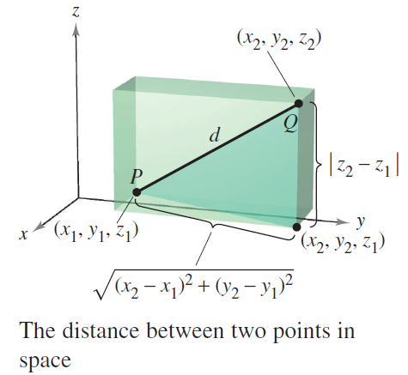
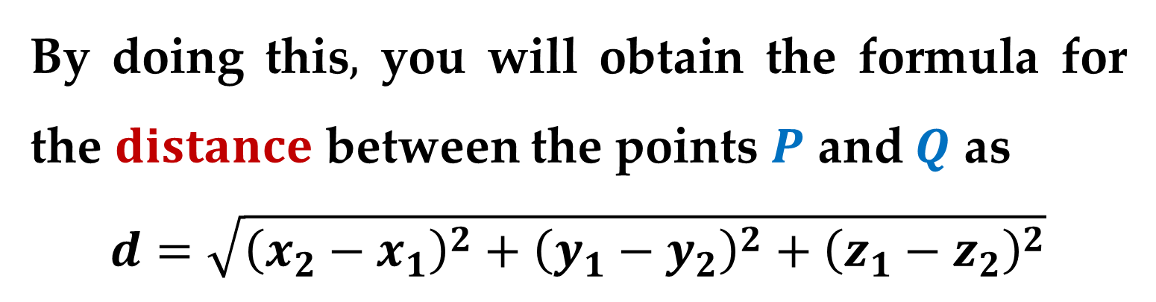
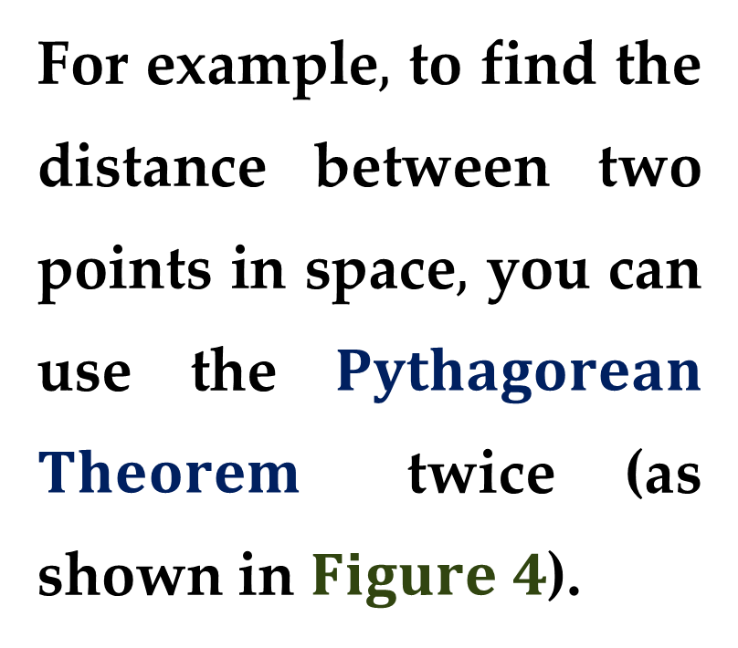
For example$,$ to find the distance between two points in space$,$ you can use the $Pythagorean$ $Theorem$ twice (as shown in $Figure 4$).
By doing this$,$ you will obtain the formula for the $distance$ between the points $P$ and $Q$ as
$$d=\sqrt{{\left(x_{2}−x_{1}\right)}^{2}+{\left(y_{1}−y_{2}\right)}^{2}+{\left(z_{1}−z_{2}\right)}^{2}}$$

Slide 11
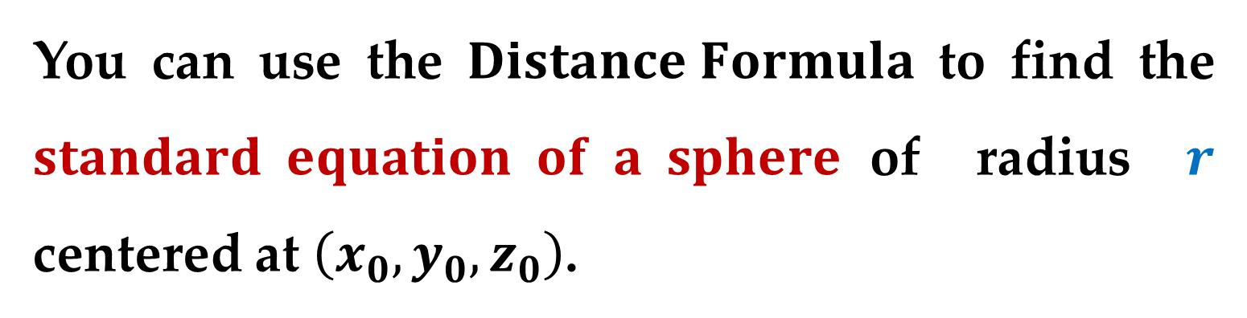
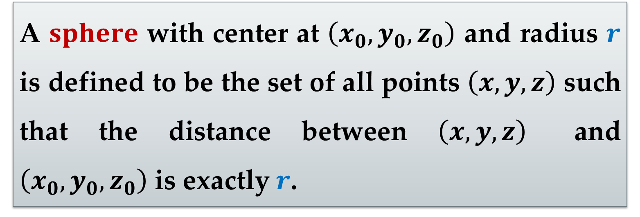
A $sphere$ with center at $\left(x_{0},y_{0},z_{0}\right)$ and radius $r$ is defined to be the set of all points $\left(x,y,z\right)$ such that the distance between $\left(x,y,z\right)$ and $\left(x_{0},y_{0},z_{0}\right)$ is exactly $r$.
You can use the $Distance Formula$ to find the $standard equation of a sphere$of radius $r$ centered at $\left(x_{0},y_{0},z_{0}\right)$.

Slide 12
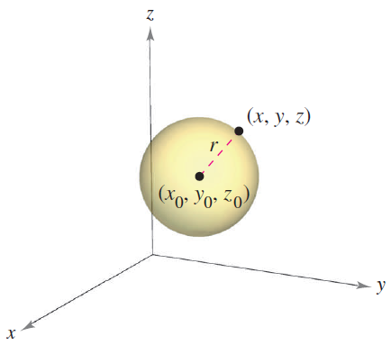
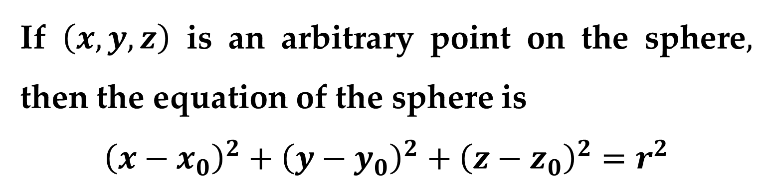
If $\left(x,y,z\right)$ is an arbitrary point on the sphere$,$ then the equation of the sphere is
$${\left(x−x_{0}\right)}^{2}+{\left(y−y_{0}\right)}^{2}+{\left(z−z_{0}\right)}^{2}=r^{2}$$

Slide 13
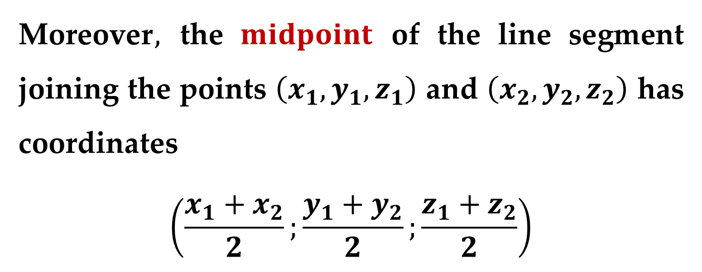
Moreover$,$ the $midpoint$ of the line segment joining the points $\left(x_{1},y_{1},z_{1}\right)$ and $\left(x_{2},y_{2},z_{2}\right)$ has coordinates
$$\left(\frac{x_{1}+x_{2}}{2};\frac{y_{1}+y_{2}}{2};\frac{z_{1}+z_{2}}{2}\right)$$

Slide 14
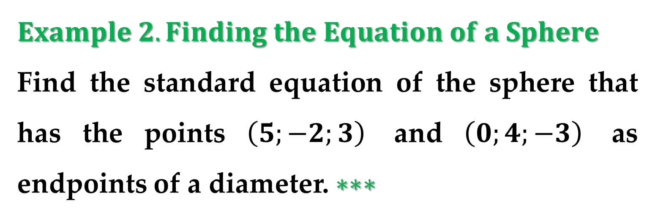
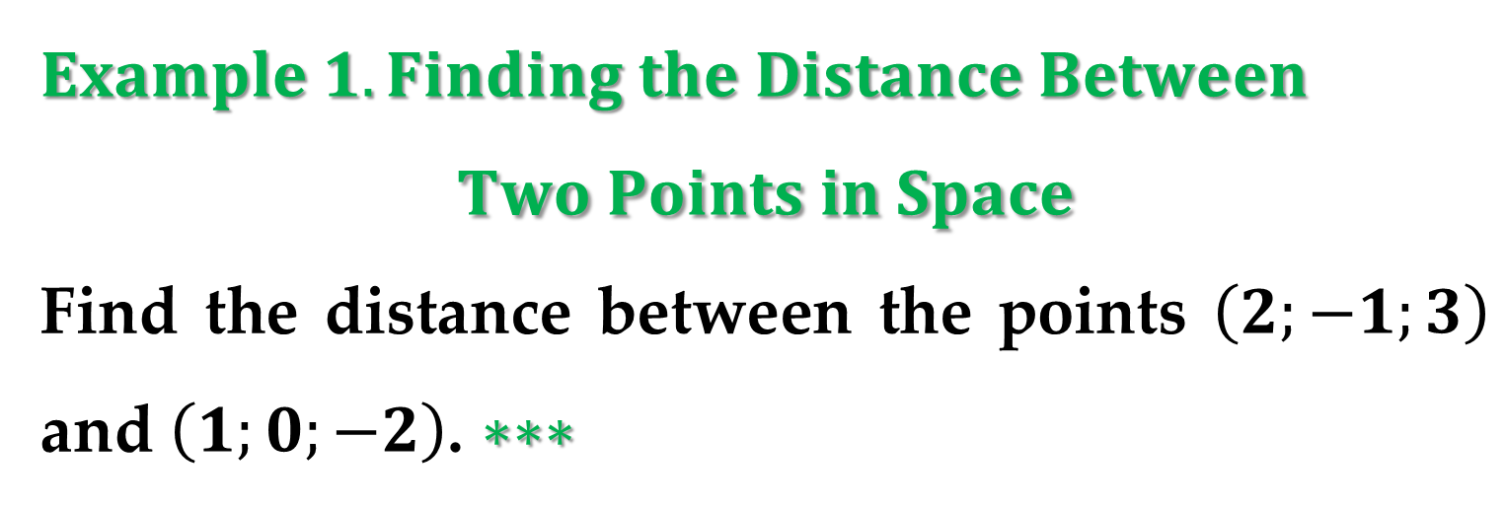
$Example 1. Finding the Distance Between$
$$Two Points in Space$$
Find the distance between the points $\left(2;−1;3\right)$ and $\left(1;0;−2\right)$. $∗∗∗$
$Example 2. Finding the Equation of a Sphere$
Find the standard equation of the sphere that has the points $\left(5;−2;3\right)$ and $\left(0;4;−3\right)$ as endpoints of a diameter. $∗∗∗$

Slide 15
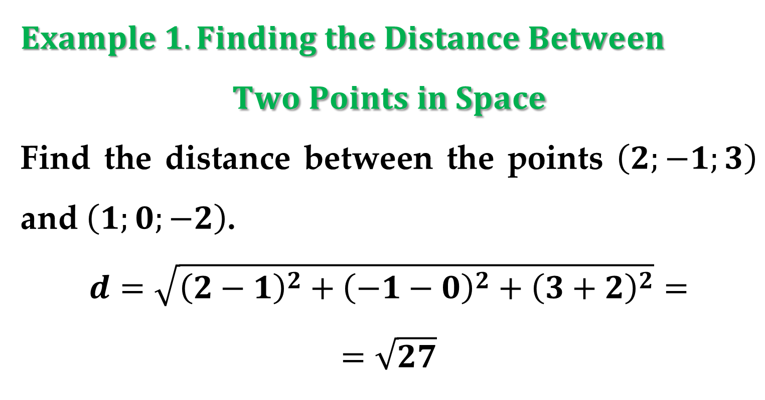
$Example 1. Finding the Distance Between$
$$Two Points in Space$$
Find the distance between the points $\left(2;−1;3\right)$ and $\left(1;0;−2\right)$.
$$d=\sqrt{{\left(2−1\right)}^{2}+{\left(−1−0\right)}^{2}+{\left(3+2\right)}^{2}}=$$
$$=\sqrt{27}$$

Slide 16
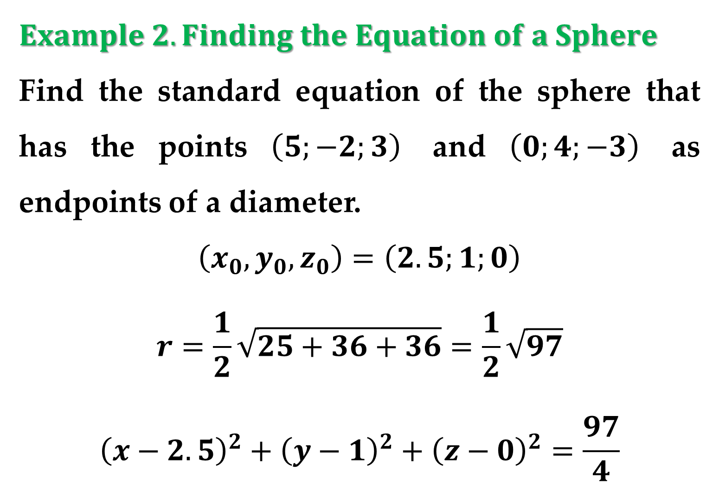
$Example 2. Finding the Equation of a Sphere$
Find the standard equation of the sphere that has the points $\left(5;−2;3\right)$ and $\left(0;4;−3\right)$ as endpoints of a diameter.
$$\left(x_{0},y_{0},z_{0}\right)=\left(2.5;1;0\right)$$
$$r=\frac{1}{2}\sqrt{25+36+36}=\frac{1}{2}\sqrt{97}$$
$${\left(x−2.5\right)}^{2}+{\left(y−1\right)}^{2}+{\left(z−0\right)}^{2}=\frac{97}{4}$$

Slide 17

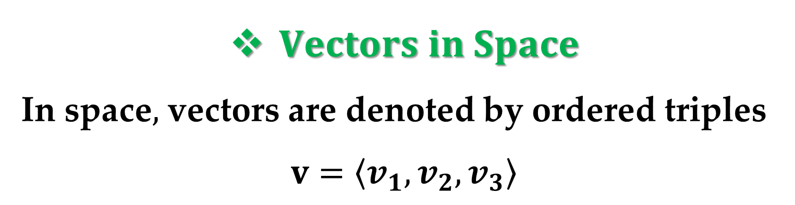
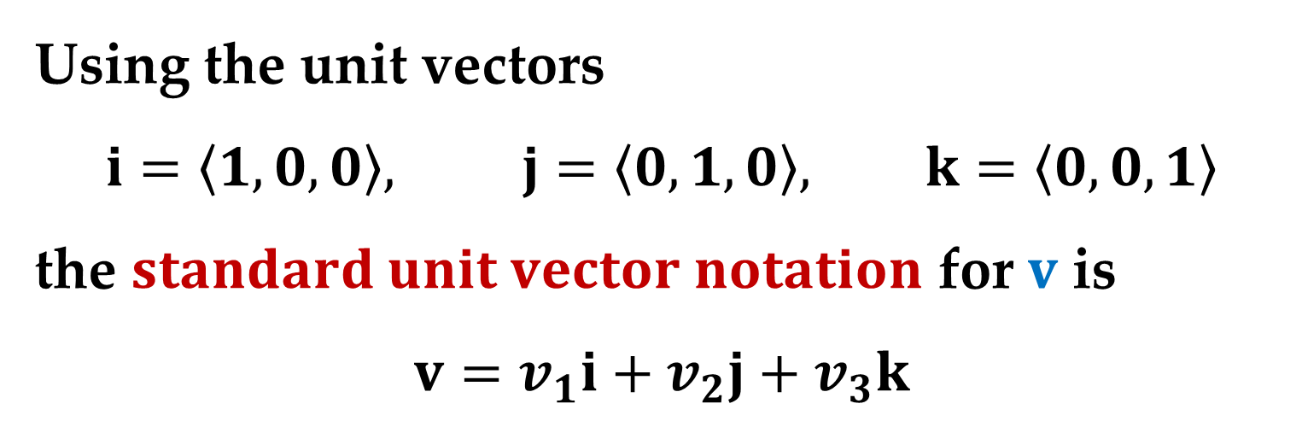
$Vectors in Space$
In space$,$ vectors are denoted by ordered triples
$$v=\left\langle v_{1},v_{2},v_{3}\right\rangle$$
The $zero vector$ is denoted by $0=\left\langle 0,0,0\right\rangle$.
Using the unit vectors
$$i=\left\langle 1,0,0\right\rangle , j=\left\langle 0,1,0\right\rangle , k=\left\langle 0,0,1\right\rangle$$
the $standard unit vector notation$ for $v$ is
$$v=v_{1}i+v_{2}j+v_{3}k$$

Slide 18
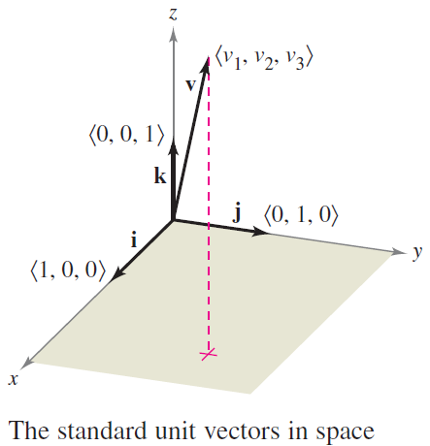
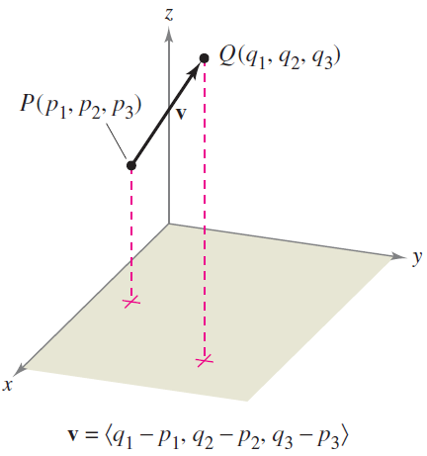
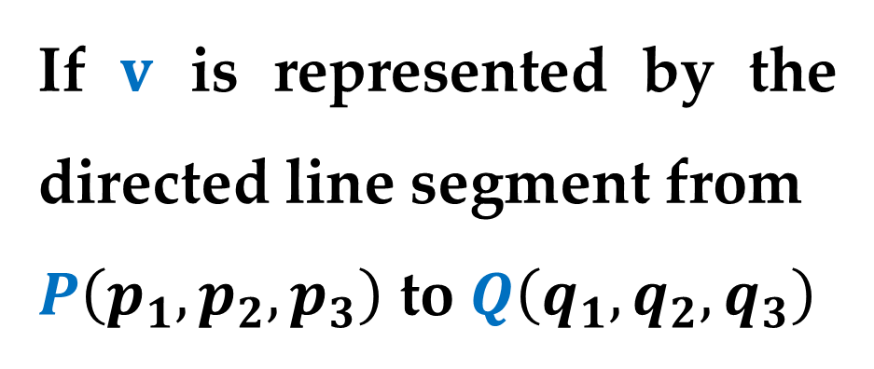

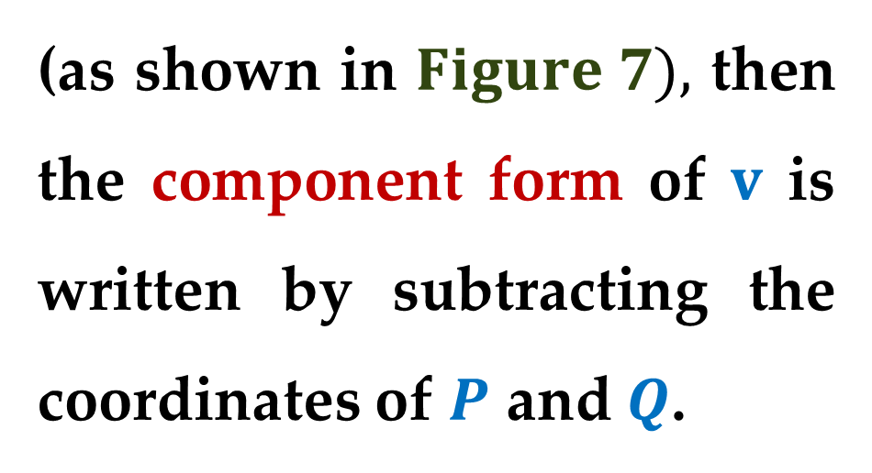
This is shown in $Figure 6$.
If $v$ is represented by the directed line segment from
$P\left(p_{1},p_{2},p_{3}\right)$ to $Q\left(q_{1},q_{2},q_{3}\right)$
(as shown in $Figure 7),$ then the component form of $v$ is written by subtracting the coordinates of $P$ and $Q$.

Slide 19
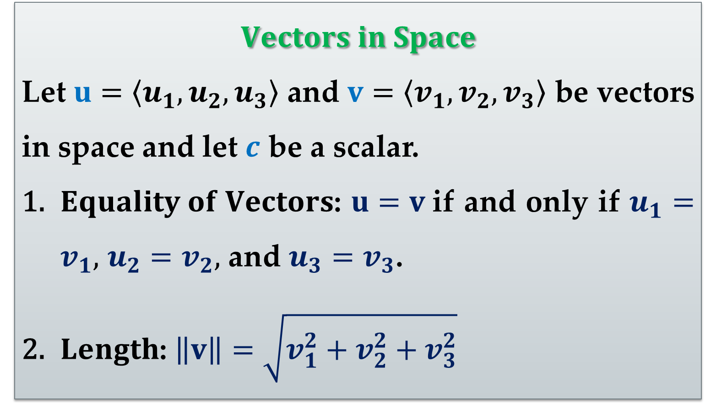
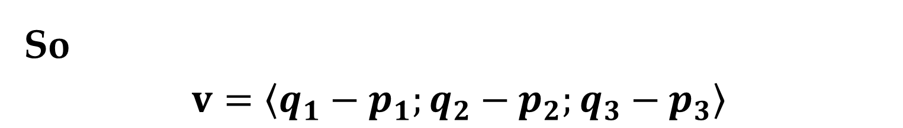
So
$$v=\left\langle q_{1}−p_{1};q_{2}−p_{2};q_{3}−p_{3}\right\rangle$$
$$Vectors in Space$$
Let $u=\left\langle u_{1},u_{2},u_{3}\right\rangle$ and $v=\left\langle v_{1},v_{2},v_{3}\right\rangle$ be vectors in space and let $c$ be a scalar.
$Equality of Vectors$: $u=v$if and only if $u_{1}=v_{1},$ $u_{2}=v_{2},$ and $u_{3}=v_{3}$.
$Length$: $\left\|v\right\|=\sqrt{v_{1}^{2}+v_{2}^{2}+v_{3}^{2}}$

Slide 20
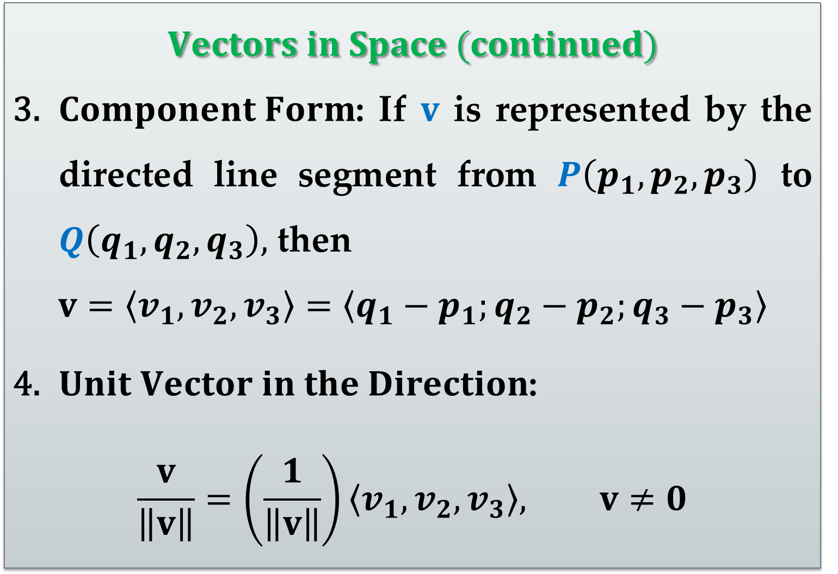
$$Vectors in Space (continued)$$
$Component Form$: If $v$ is represented by the directed line segment from $P\left(p_{1},p_{2},p_{3}\right)$ to $Q\left(q_{1},q_{2},q_{3}\right),$ then
$$v=\left\langle v_{1},v_{2},v_{3}\right\rangle =\left\langle q_{1}−p_{1};q_{2}−p_{2};q_{3}−p_{3}\right\rangle$$
$Unit Vector in the Direction$:
$$\frac{v}{\left\|v\right\|}=\left(\frac{1}{\left\|v\right\|}\right)\left\langle v_{1},v_{2},v_{3}\right\rangle , v≠0$$

Slide 21
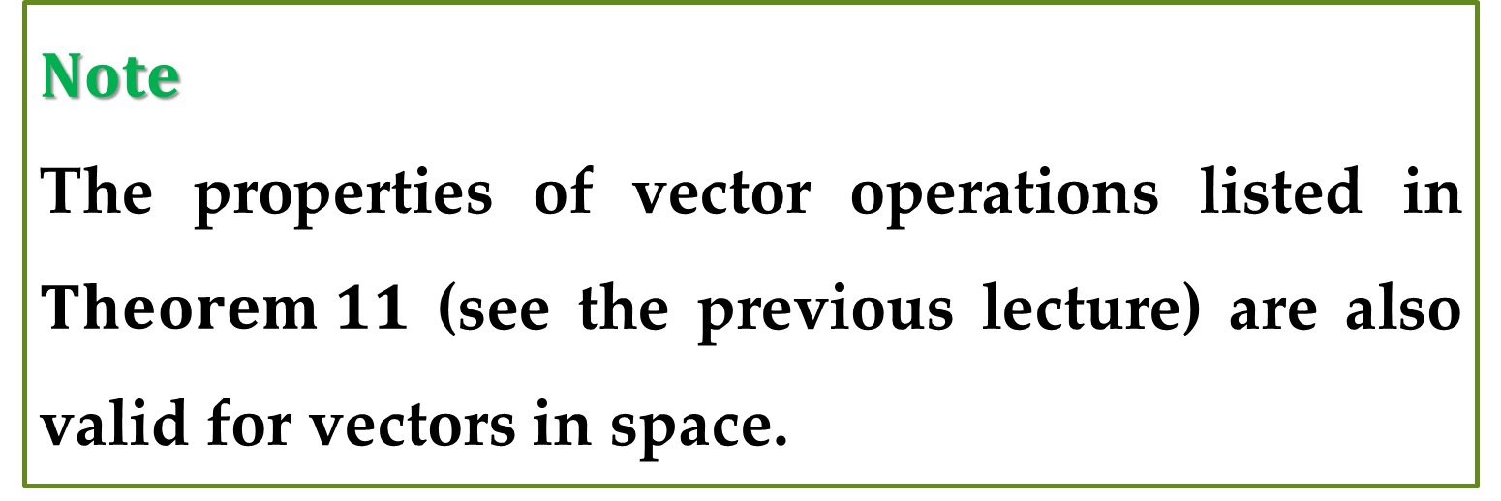
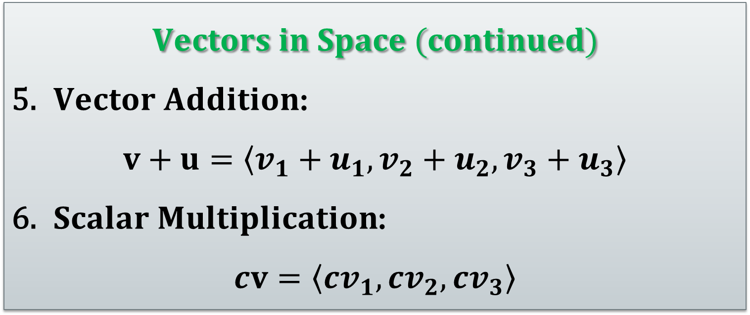
$$Vectors in Space (continued)$$
$Vector Addition$:
$$v+u=\left\langle v_{1}+u_{1},v_{2}+u_{2},v_{3}+u_{3}\right\rangle$$
$Scalar Multiplication$:
$$cv=\left\langle cv_{1},cv_{2},cv_{3}\right\rangle$$
$Note$
The properties of vector operations listed in $Theorem 11$ (see the previous lecture) are also valid for vectors in space.

Slide 22
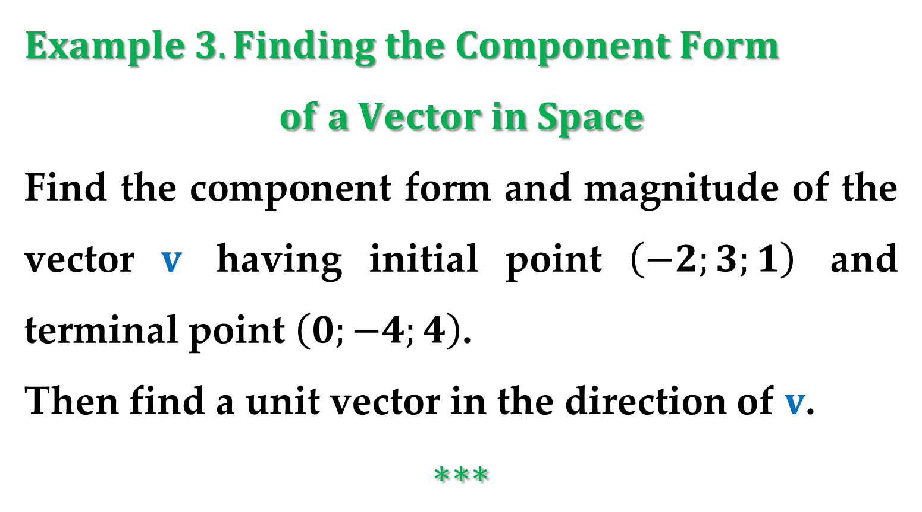
$Example 3. Finding the Component Form$
$$of a Vector in Space$$
Find the component form and magnitude of the vector $v$ having initial point $\left(−2;3;1\right)$ and terminal point $\left(0;−4;4\right)$.
Then find a unit vector in the direction of $v$.
$$∗∗∗$$

Slide 23
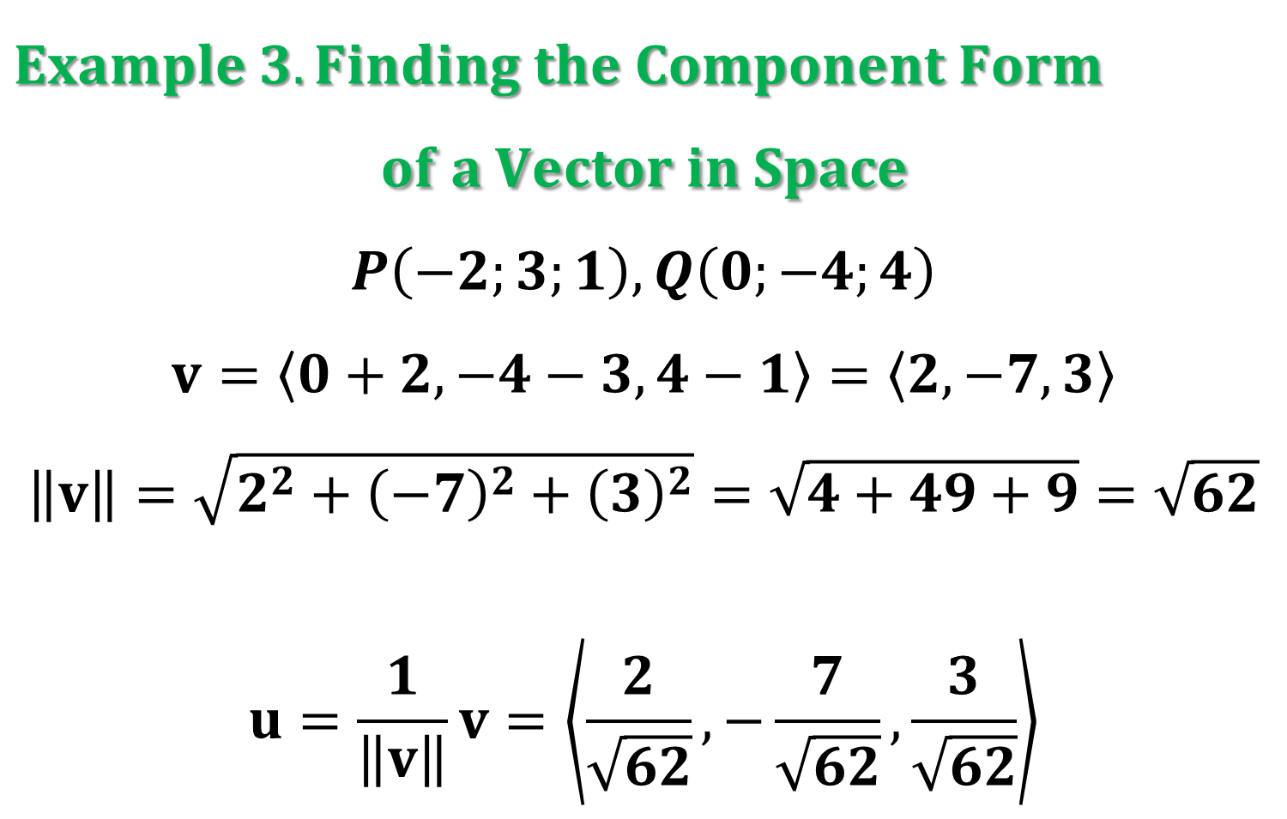
$Example 3. Finding the Component Form$
$$of a Vector in Space$$
$$P\left(−2;3;1\right), Q\left(0;−4;4\right)$$
$$v=\left\langle 0+2, −4−3,4−1\right\rangle =\left\langle 2,−7,3\right\rangle$$
$$\left\|v\right\|=\sqrt{2^{2}+{\left(−7\right)}^{2}+{\left(3\right)}^{2}}=\sqrt{4+49+9}=\sqrt{62}$$
$$u=\frac{1}{\left\|v\right\|}v=\left\langle \frac{2}{\sqrt{62}},−\frac{7}{\sqrt{62}},\frac{3}{\sqrt{62}}\right\rangle$$

Slide 24
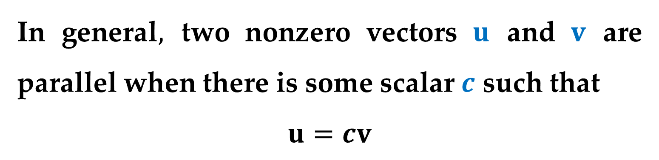
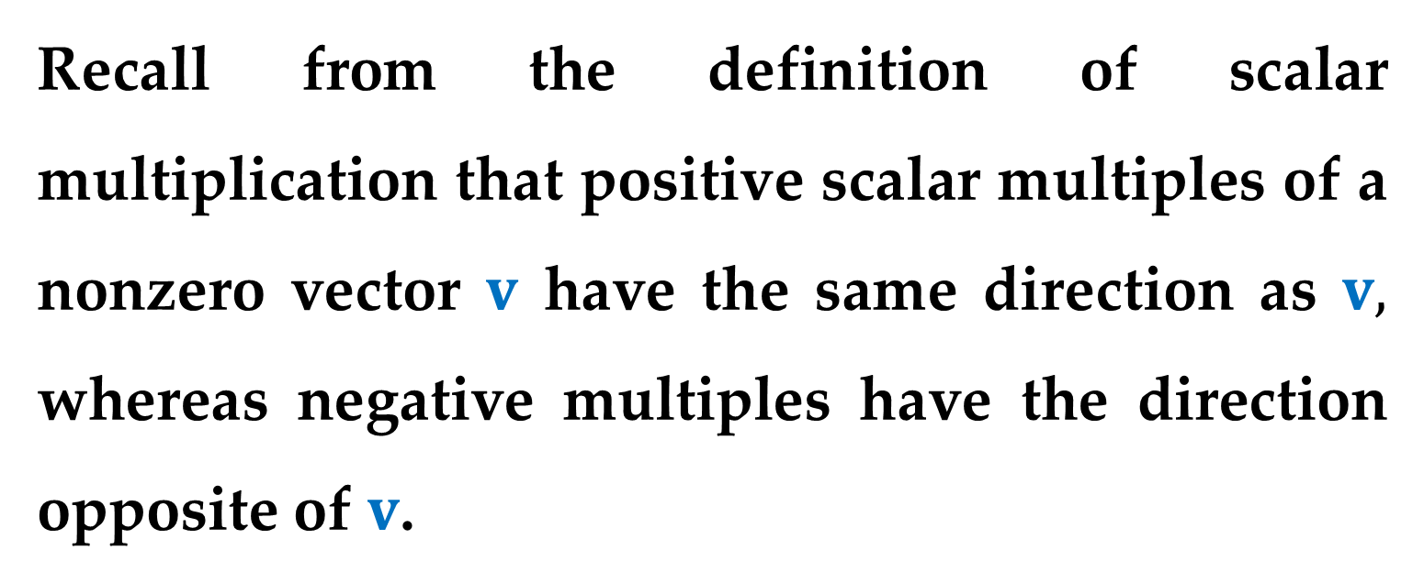
Recall from the definition of scalar multiplication that positive scalar multiples of a nonzero vector $v$ have the same direction as $v,$ whereas negative multiples have the direction opposite of $v$.
In general$,$ two nonzero vectors $u$ and $v$ are parallel when there is some scalar $c$ such that
$$u=cv$$

Slide 25
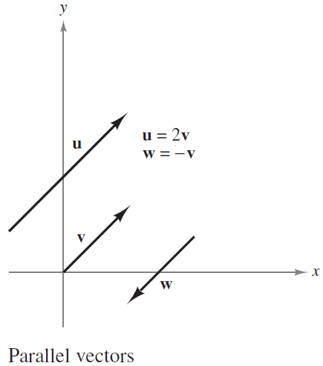
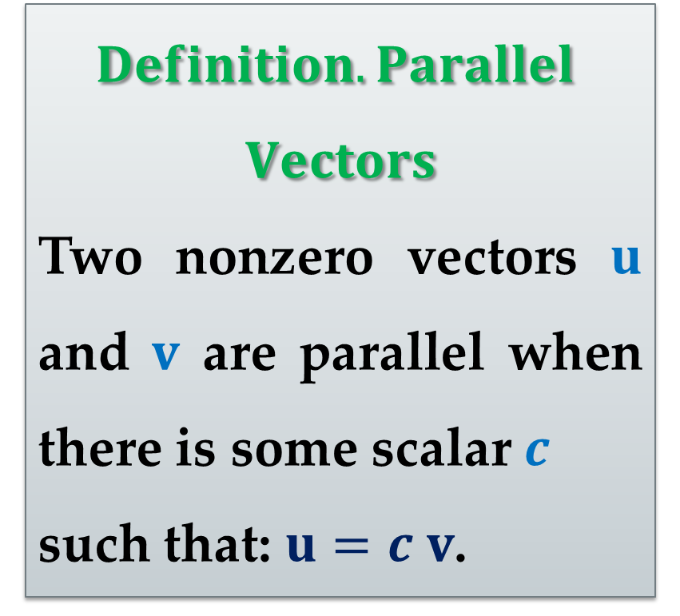
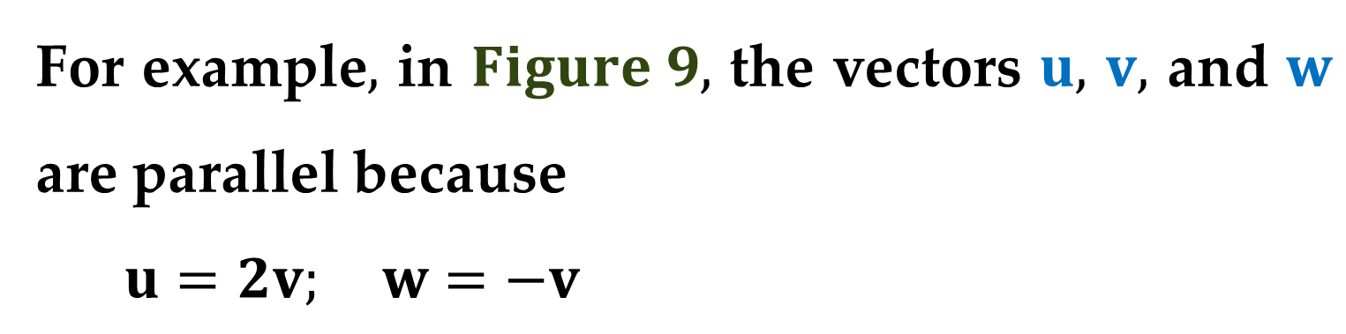
For example$,$ in $Figure 9,$ the vectors $u,$ $v,$ and $w$ are parallel because
$u=2v; w=−v$
$$Definition. Parallel$$
$$Vectors$$
Two nonzero vectors $u$ and $v$ are parallel when there is some scalar $c$
such that: $u=c v$.

Slide 26
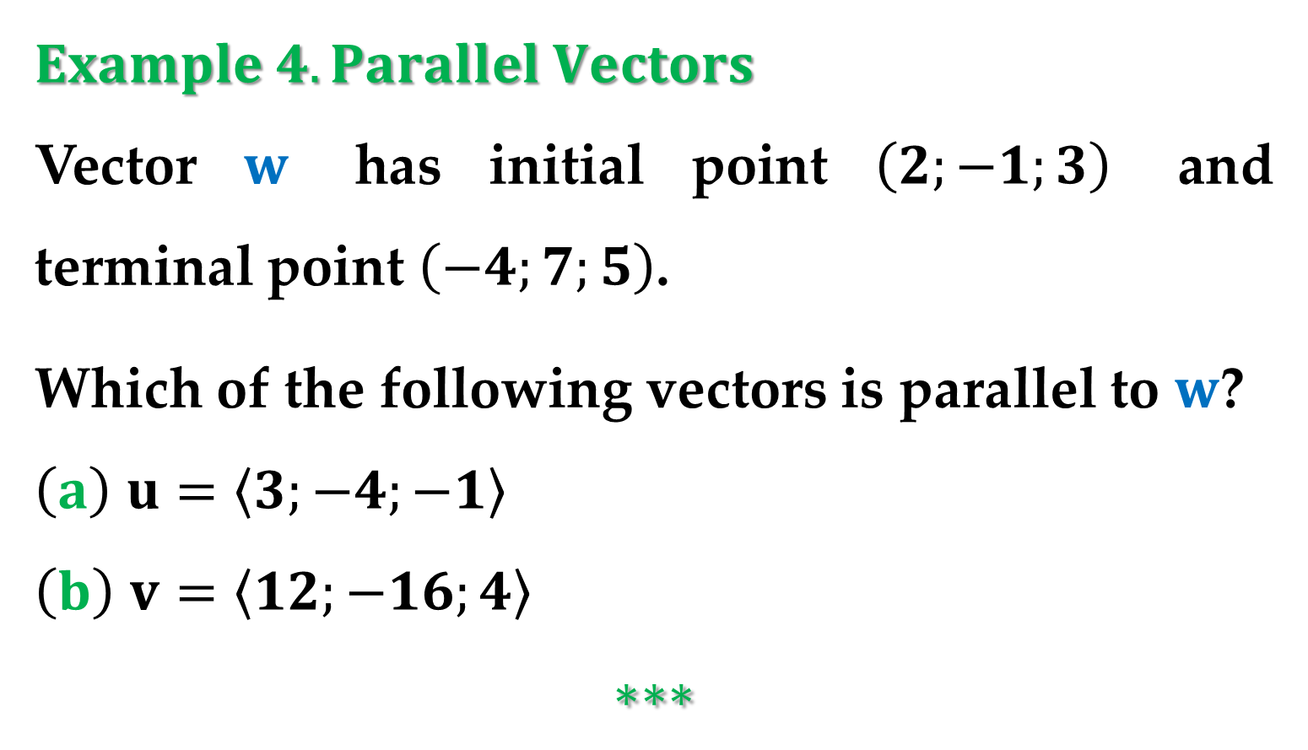
$Example 4. Parallel Vectors$
Vector $w$ has initial point $\left(2;−1;3\right)$ and terminal point $\left(−4;7;5\right)$.
Which of the following vectors is parallel to $w$?
$\left(a\right)$ $u=\left\langle 3;−4;−1\right\rangle$
$\left(b\right)$ $v=\left\langle 12;−16;4\right\rangle$
$$∗∗∗$$

Slide 27
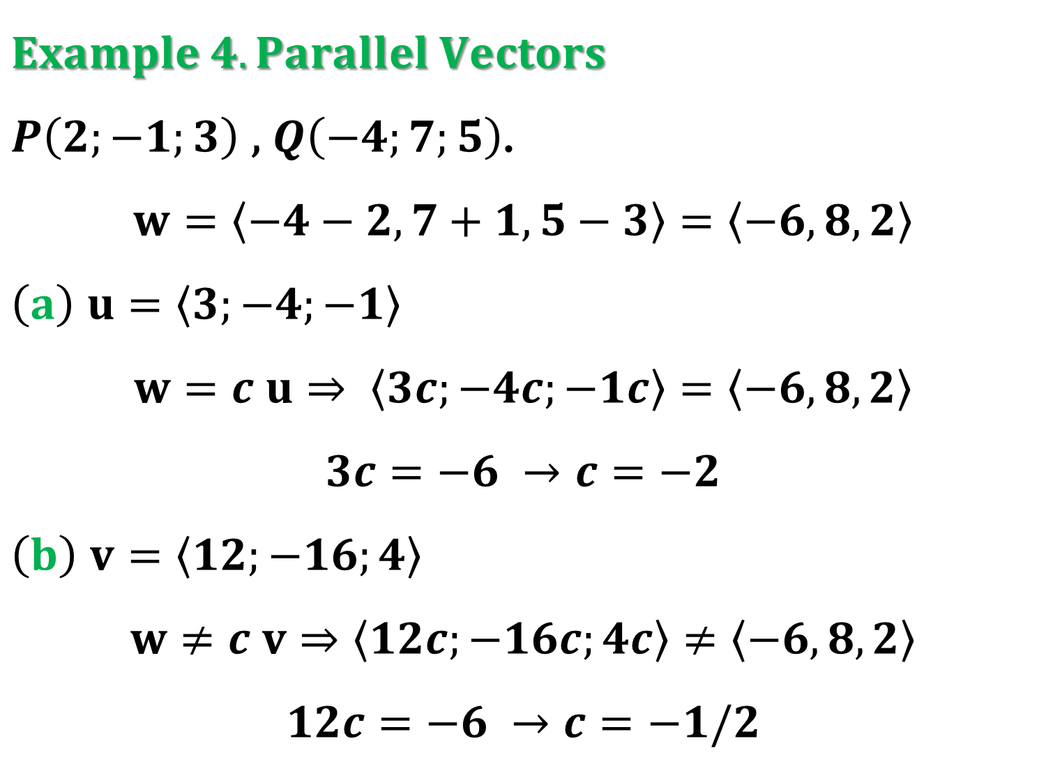
$Example 4. Parallel Vectors$
$P\left(2;−1;3\right)$ , $Q\left(−4;7;5\right)$.
$$w=\left\langle −4−2,7+1,5−3\right\rangle =\left\langle −6,8,2\right\rangle$$
$\left(a\right)$ $u=\left\langle 3;−4;−1\right\rangle$
$$w=c u⇒ \left\langle 3c;−4c;−1c\right\rangle =\left\langle −6,8,2\right\rangle$$
$$3c=−6 →c=−2$$
$\left(b\right)$ $v=\left\langle 12;−16;4\right\rangle$
$$w≠c v⇒\left\langle 12c;−16c;4c\right\rangle ≠\left\langle −6,8,2\right\rangle$$
$$12c=−6 →c=−1/2$$

Slide 28
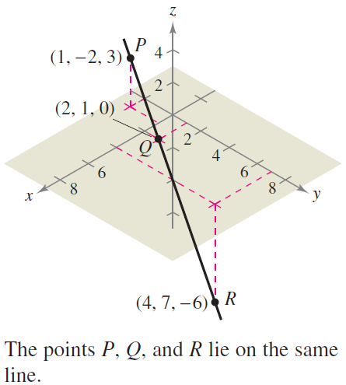

$Example 5. Using Vectors to Determine$
$$Collinear Points$$
Determine whether the points
$P\left(1;−2;3\right), Q\left(2;1;0\right),$
$R\left(4;7;−6\right)$
are collinear.
$∗∗∗$

Slide 29

$Example 5. Using Vectors to Determine$
$$Collinear Points$$
Determine whether the points
$P\left(1;−2;3\right), Q\left(2;1;0\right),$ $R\left(4;7;−6\right)$
are collinear.
$$\vec{PR}=\sqrt{{\left(4−1\right)}^{2}+{\left(7+2\right)}^{2}+{\left(−6−3\right)}^{2}}=\sqrt{171}$$
$$\vec{PQ}=\sqrt{{\left(2−1\right)}^{2}+{\left(1+2\right)}^{2}+{\left(0−3\right)}^{2}}=\sqrt{19}$$
$$\vec{QR}=\sqrt{{\left(4−2\right)}^{2}+{\left(7−1\right)}^{2}+{\left(−6−0\right)}^{2}}=\sqrt{76}$$
$$\sqrt{171}=\sqrt{19}+\sqrt{76}$$

Slide 30

$Example 6. Standard Unit Vector Notation$
$\left(a\right)$ Write the vector $v=4i−5k$ in component form.
$\left(b\right)$ Find the terminal point of the vector
$$u=7i−j+3k$$
given that the initial point is $P\left(−2;3;5\right)$.
$\left(c\right)$ Find the magnitude of the vector
$$w=−6i+2j−3k$$
Then find a unit vector in the direction of $w$.

Slide 31

$Example 6. Standard Unit Vector Notation$
$\left(a\right)$ Write the vector $v=4i−5k$ in component form.
$$v=\left\langle 4,0,−5\right\rangle$$

Slide 32

$Example 6. Standard Unit Vector Notation$
$\left(b\right)$ Find the terminal point of the vector
$$u=7i−j+3k$$
given that the initial point is $P\left(−2;3;5\right)$.
$$Q\left(q_{1},q_{2},q_{3}\right) −terminal point$$
$$\left\langle 7,−1,3\right\rangle =\left\langle q_{1}+2,q_{2}−3,q_{3}−5\right\rangle$$
$$q_{1}=5; q_{2}=2; q_{3}=8$$

Slide 33

$Example 6. Standard Unit Vector Notation$
$\left(c\right)$ Find the magnitude of the vector
$$w=−6i+2j−3k$$
Then find a unit vector in the direction of $w$.
$$\left\|w\right\|=\sqrt{{\left(−6\right)}^{2}+{\left(2\right)}^{2}+{\left(−3\right)}^{2}}=\sqrt{49}=7$$
$$\frac{1}{\left\|w\right\|}w=\frac{1}{7}\left(−6i+2j−3k\right)=−\frac{6}{7}i+\frac{2}{7}j−\frac{3}{7}k$$

Slide 34


$Example 7. Measuring Force$
A television camera weighing $120$ pounds is supported by a tripod$,$
as shown in $Figure 11$.
Represent the force exerted on each leg of the tripod as a vector.

Slide 35


Solution
Let the vectors $F_{1},$ $F_{2},$ and $F_{3}$ represent the forces exerted on the three legs.
From $Figure 11,$ you can determine the directions of $F_{1},$ $F_{2},$ and $F_{3}$ to be as follows:
$$\vec{PQ_{1}}=\left\langle 0−0;−1−0;0−4\right\rangle =\left\langle 0;−1;−4\right\rangle$$
$$\vec{PQ_{2}}=\left\langle \frac{\sqrt{3}}{2}−0;\frac{1}{2}−0;0−4\right\rangle =\left\langle \frac{\sqrt{3}}{2};\frac{1}{2};−4\right\rangle$$

Slide 36



Solution (continued)
$$\vec{PQ_{3}}=\left\langle −\frac{\sqrt{3}}{2}−0;\frac{1}{2}−0;0−4\right\rangle =\left\langle −\frac{\sqrt{3}}{2};\frac{1}{2};−4\right\rangle$$
Because each leg has the same length$,$ and the total force is distributed equally among the three legs$,$ you know that
$$\left\|F_{1}\right\|=\left\|F_{2}\right\|=\left\|F_{3}\right\|$$
So$,$ there exists a constant $c$ such that
$$F_{1}=c\vec{PQ_{1}}; F_{2}=c\vec{PQ_{2}}; F_{3}=c\vec{PQ_{3}}$$

Slide 37



Solution (continued)
Let the total force exerted by the object be given by $F=\left\langle 0;0;−120\right\rangle$.
Then$,$ using the fact that
$$F=F_{1}+F_{2}+F_{3}$$
you can conclude that $F_{1},$ $F_{2},$ and $F_{3}$ all have a vertical component of $−40$.
This implies that $c\left(−4\right)=−40$ and $c=10$.

Slide 38

Solution (continued)
Therefore$,$ the forces exerted on the legs can be represented by
$$F_{1}=\left\langle 0;−10;−40\right\rangle$$
$$F_{2}=\left\langle 5\sqrt{3};5;−40\right\rangle$$
$$F_{3}=\left\langle −5\sqrt{3};5;−40\right\rangle$$

Slide 39
Thank you for attention

